Slide 1
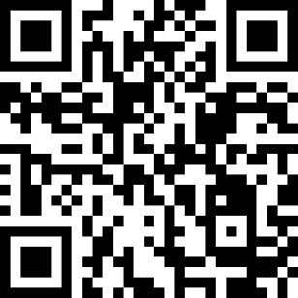
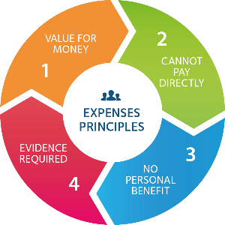
Claiming expenses?
From date 2021 use
SAP® Concur® eExpenses
for most expense claims
More information:
Department contact:
[Insert local contact details]
https://finance.admin.ox.ac.uk/expenses

