Slide 1
Specify the Need

Slide 2
Specify the Need
(+ Market Sounding)
Identify Suppliers
Invite Tenders
Evaluate Tenders
Award Contract

Slide 3
Market Sounding
Prior to tendering
Assess market reaction / gain insight
Specification development
Solution options
Commercial approach
Benefits
Feasibility
Capacity
Capability
Innovation / Trends
Maturity
Interest

Slide 4
Format
No defined process
Not supplier selection
No commitment
Short written scope / questions
Presentations
Discussion / site visits

Slide 5
Practicalities
Transparent – process & timescales
Promote your opportunity
Be open to change
Confidential information
Keep notes

Slide 6
Specify Need
Specification = a statement of need to be satisfied by the purchase of external resources
Consult relevant stakeholders
Aim to present suppliers with a clear, accurate and full description of need
Enables suppliers to propose appropriate solutions
Notes:
Once you’ve conducted all your information gathering you should be in a position to draft the specification.
The specification is the document which sets out all your needs.
If these are complex you may want to consult a range of stakeholders in its preparation.
It’s common sense, but the aim is to present suppliers with a clear, accurate and full description of your requirements.
So that they can propose solutions to meet your need.
As we mentioned in the first video, the benefit of this approach is that if ultimately the solution doesn’t meet your requirements contractually this will be the supplier’s issue to resolve as by tendering they are confirming the solution meets the requirements, unless they make specific comments to the contrary in their proposal.

Slide 7
Specification Content
Background – provide context
State expected outcomes (‘what’ not ‘how’)
Use clear, unambiguous language
‘the supplier shall…’ / ’the solution must…’
Avoid jargon and ensure acronyms are expanded on first use
Distinguish mandatory and desirable requirements
Where possible, avoid discriminating e.g. using brand names
Consider sustainability

Slide 8
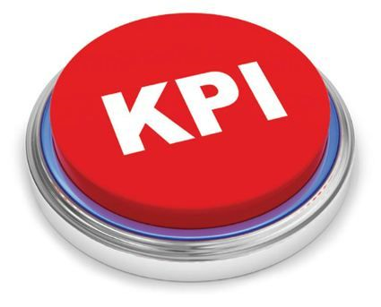
Specification – Future Proofing
Include performance indicators to enable effective contract management
Consider future developments - including ‘options’ makes future extension of the contract easier
Think about ongoing requirements e.g. servicing / consumables

